Slide 1
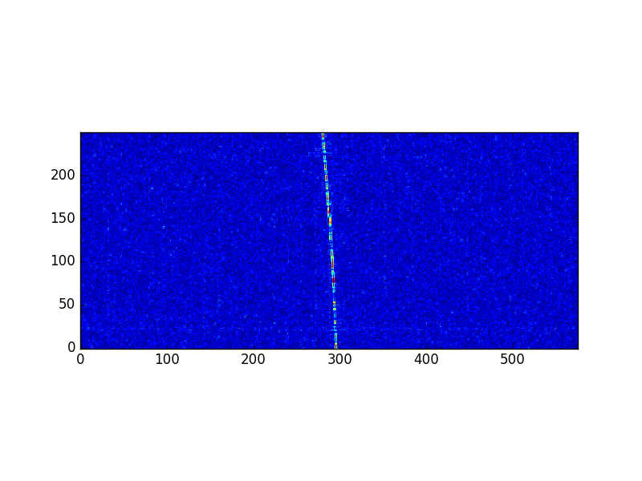

NEW SPACE OPERATIONS IN
THE INTERNET OF THINGS ERA
- ANYWHERE, ANYTIME, ANYTHING!
IAC2016, Guadalajara, Small Sat Operations (B4.3)
Andreas HORNIG
hornig@aerospaceresearch.net
University of Stuttgart
Prof. Dieter FRITSCH
IFP, University of Stuttgart
what is this?
Saudi-OSCAR 50?
2002-058C
436.800 MHz
2016-09-27 | IAC-16-B4.3.2-x33536
1

Slide 2
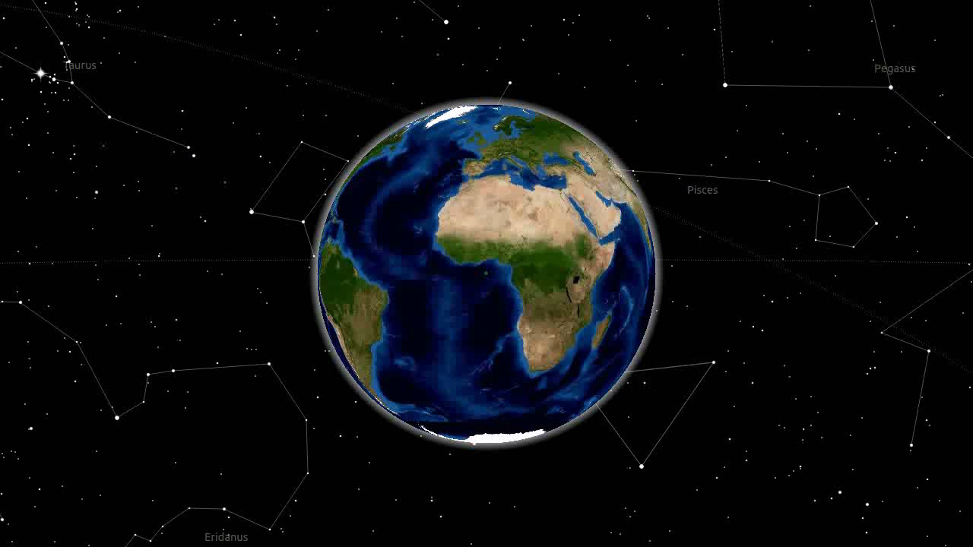
In 2013 the Global Standards Initiative on Internet of Things (IoT-GSI) defined the IoT as
"the infrastructure of the information society“.
ITU, Internet of Things Global Standards Initiative (Geneva)
According to estimations for 2020, IoT will consist
“of almost 50 billion objects and interconnection is expected
to usher in automation in nearly all fields”.
Dave Evans, Cisco “The Internet of Things,” April 2011.
2

Slide 3
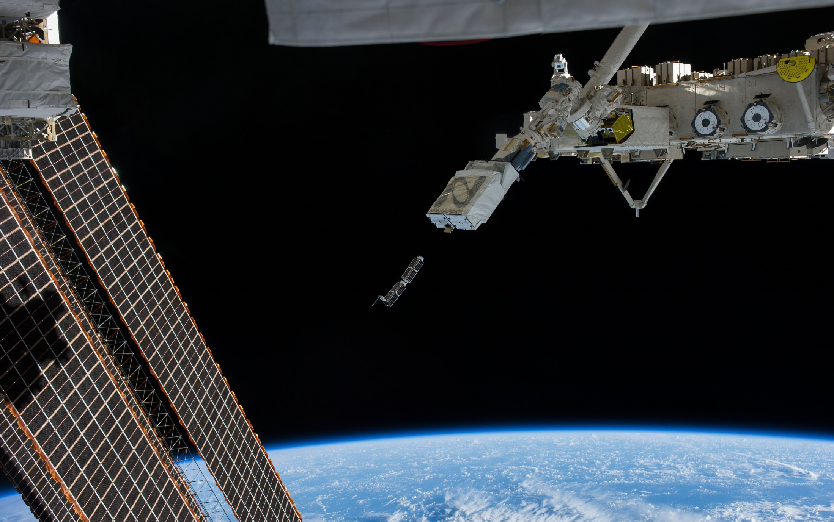
Why?
Some CubeSats
Lost in Space! ;)
But not for long
"Today: NanoRacks Inadvertent Deploy:
On Saturday, ground teams observed the inadvertent deploy of two Cosmogia CubeSats from Deployer #5 of the NanoRack Cubesat Deployer (NRCSD).
src: www.nasa.gov/content/nanoracks-cubesats-are-deployed
September 5, 2014
nasawatch.com/archives/2014/09/problems-persis.html
3

Slide 4
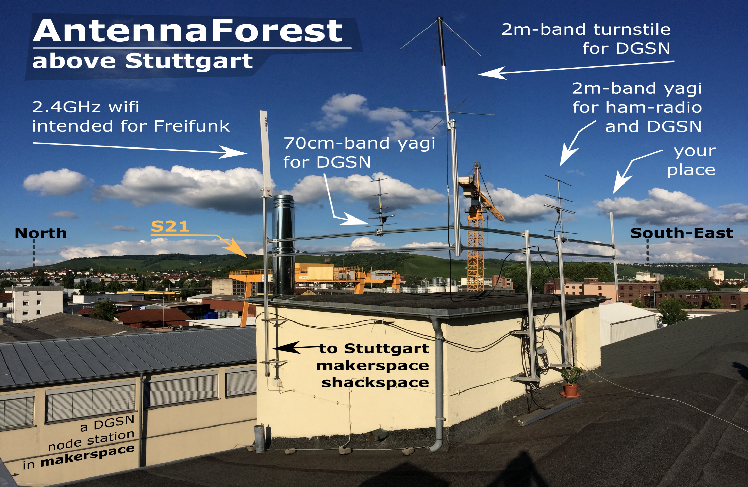
one groundstation above Stuttgart
„AntennaForest“
4

Slide 5
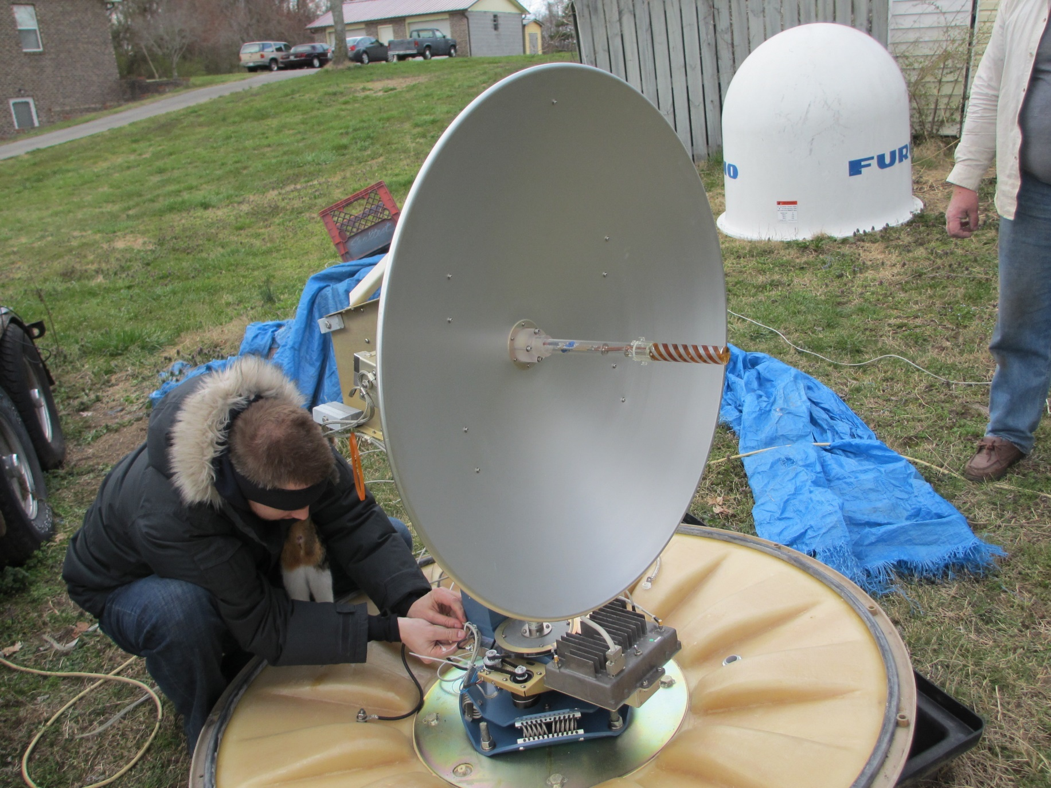
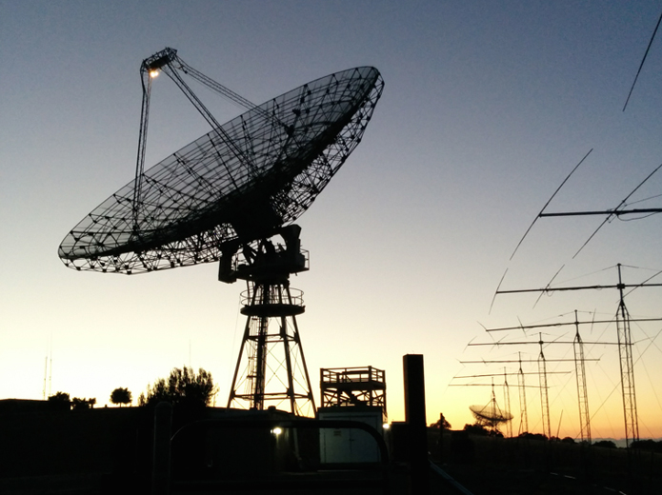
What else can you do?
Many more things!
please stay & ask
LeafSpace B4.3.2
Helen/Ukube-1 B4.3.1
during their talks ;)
http://spacecollege.org/isee3/isee-3-reboot-team-at-the-stanford-dish.html
http://travisgoodspeed.blogspot.mx/2013/07/hillbilly-tracking-of-low-earth-orbit.html?m=1
hacker prepares
satellite port scan
hobbyists re-activate
NASA satellite
Travis Goodspeed
US-Navy Inmarsat Dish
ISEE-3 Reboot
Stanford Dish
5

Slide 6
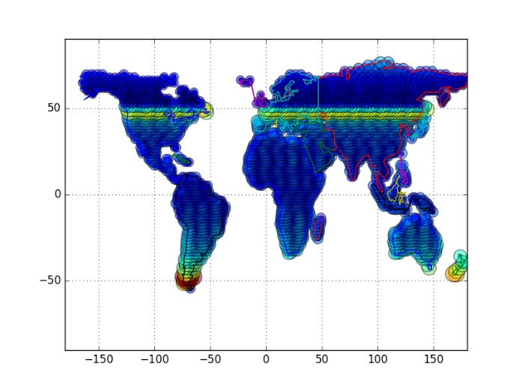
anywhere
reaching the network limits!
Latitude [°]
Comparison of DGSN with typical ground station
DGSN station: fixed antenna with elevation > 60
Typical station: motorized antenna with elevation > 10
Satellite constellations: 2 planes (50° and 95°)
18 sats (12 and 6)
Longitude [°]
6

Slide 7
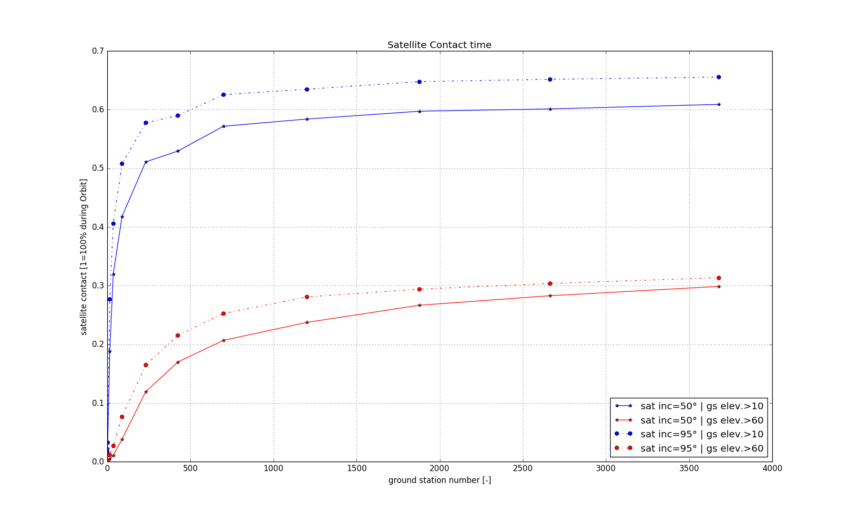
anywhere
typical motorized
ground station
DGSN
Simulation of visibility time
15 days
ground stations on equal spaces, but just on continental land
7

Slide 8
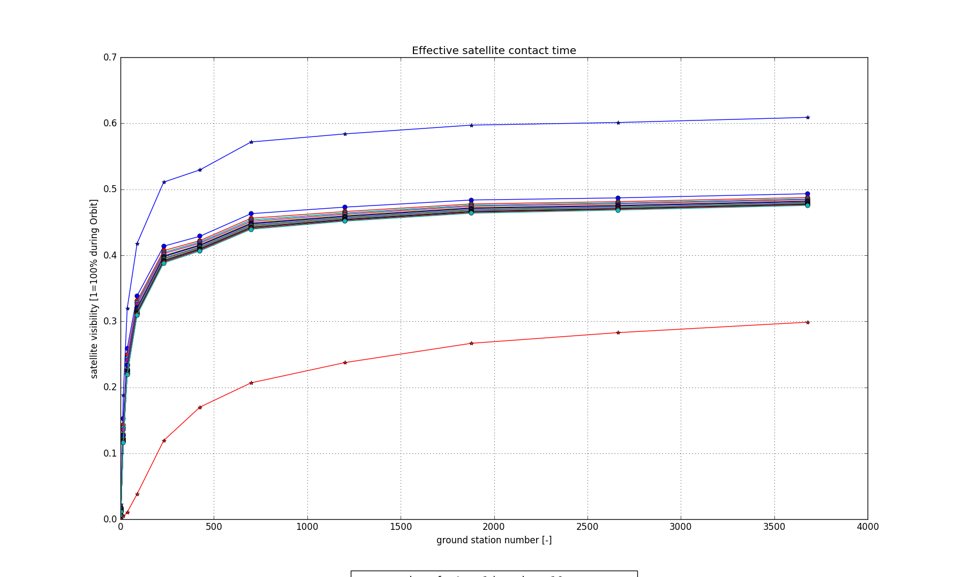

anytime
typical motorized
ground station
tracked contact time
& lambda = 0.81
DGSN
Simulation of contact time
Visibility time corrected by tracking effects and lambda = 0.81 availability per ground station
$$P_{node}= \prod_{i=1}^{n}{λ_{i}∗T}$$
8

Slide 9
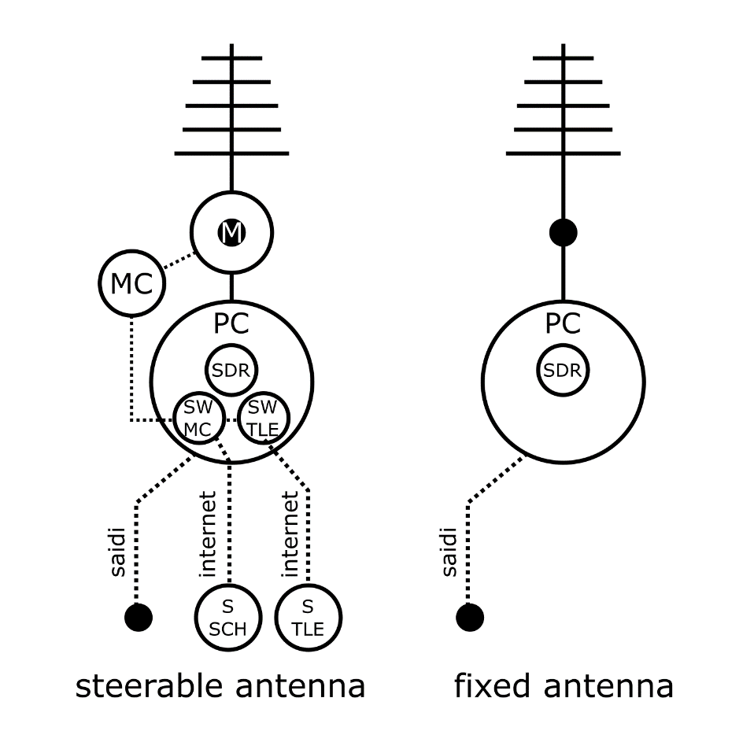
Ground Station Components | λ for components of Ground Station w/ steerable antenna (elevation > 10°) | λ for components of Ground Station w/ fixed antenna (elevation > 60°)
Computer including… | 0.97011 | 0.98981
-SAIDI [13] (EU average) | 0.99981 | 0.99981
-SW SDR | 0.99 | 0.99
-SW Motor-Control | 0.99 | -
-SW TLE Scheduler | 0.99 | -
Antenna including… | 0.94411 | -
-Motor | 0.95 | -
-Microcontroller | 0.9938 | -
TLE Server | 0.97 | -
Internet [14] to TLE | 0.97 | -
Scheduler Server | 0.97 | -
Internet [14] to Scheduler | 0.97 | -
Total System | 0.81083 | 0.98981
Table 1: Title of table, left justified, subsequent text indented. Heading centred. Do not use vertical lines within the table; use horizontal lines only to separate headings from table entries
anytime
Don’t forget, complex systems break, too!
$$P_{node}= \prod_{i=1}^{n}{λ_{i}∗T}$$
9

Slide 10
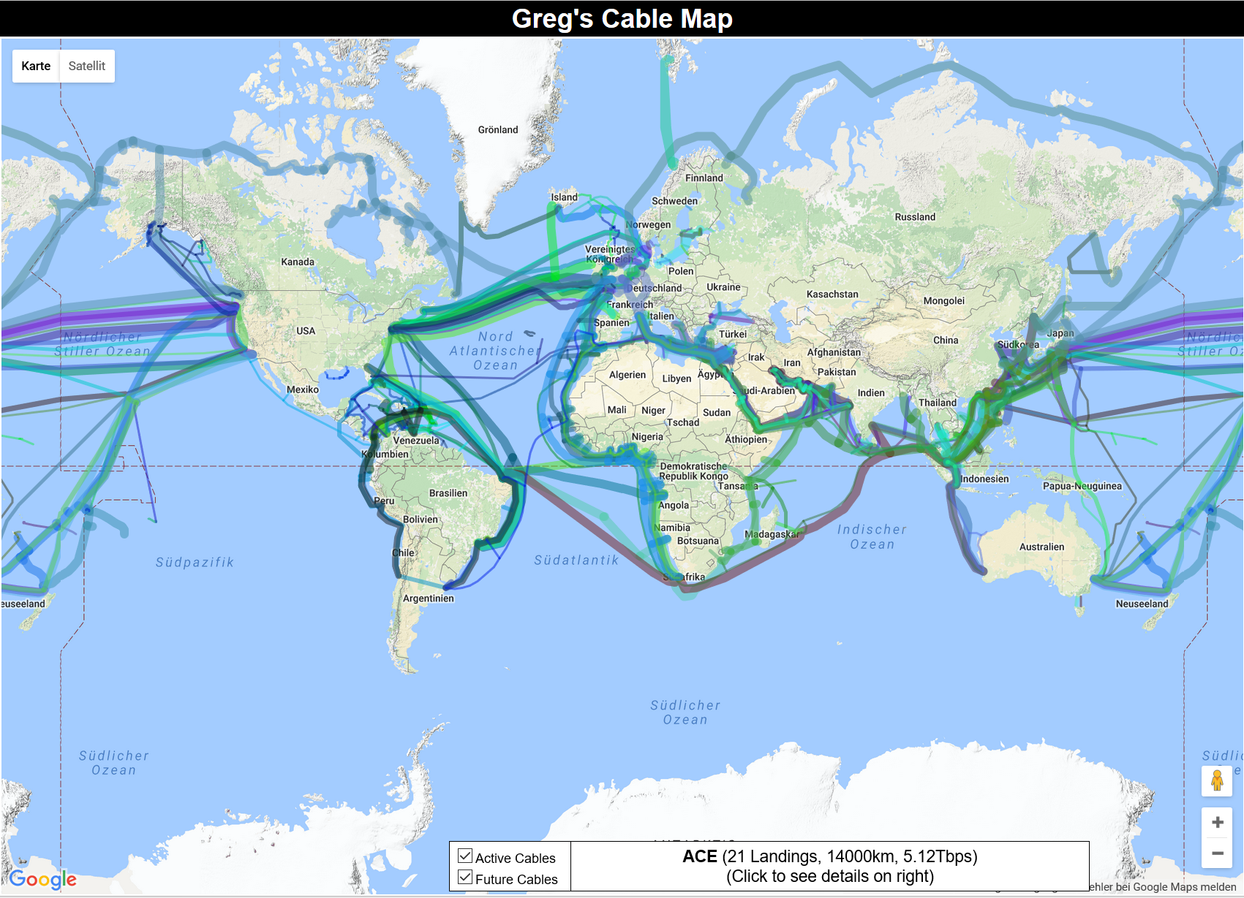
anything
Selecting the location by available infrastructure
src: http://www.cablemap.info/ gpl-3.0
anywhere + anytime + anything = high data demand
selection of ground station location according to submarine communication cables
10

Slide 11
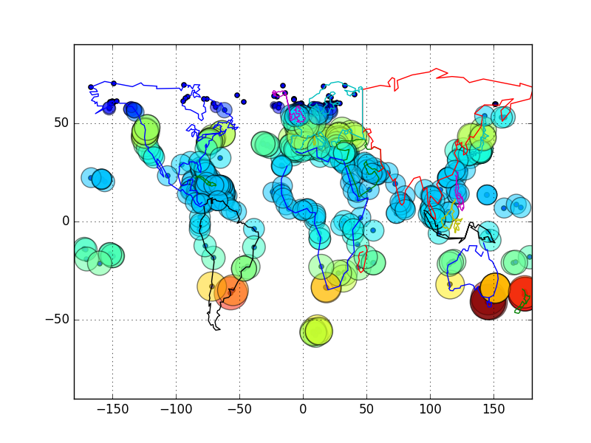
anything
Latitude [°]
Ground Stations on sea cable landing points
similar contact times as on regular grid
Longitude [°]
11

Slide 12
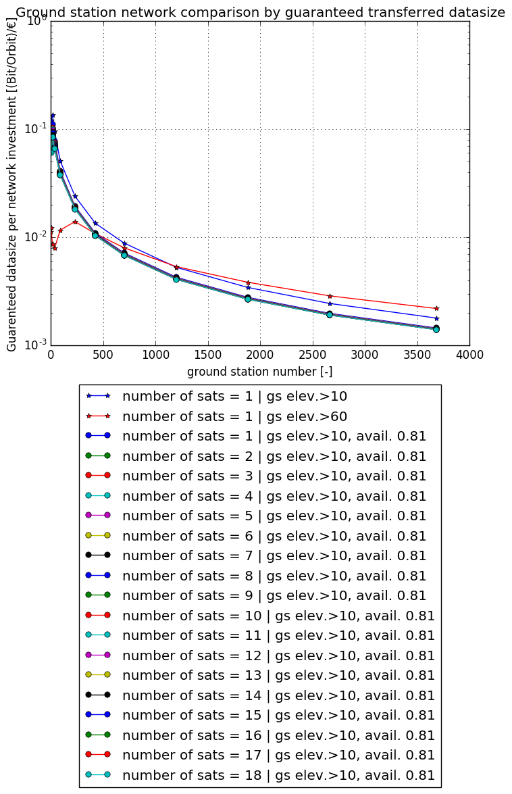

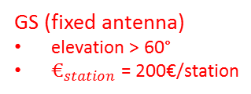
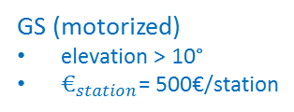
Paradigm Shift – comparison metric
guaranteed transferred data size per orbit
instead of guaranteed data-rate
$$G=\frac{data size per orbit}{infrastructure costs}=\frac{t_{tracked} ∗ T_{orbit}∗D}{n_{stations}∗€_{station}}$$
GS (fixed antenna)
elevation > 60°
$€_{station}$ = 200€/station
GS (motorized)
elevation > 10°
$€_{station}$= 500€/station
12

Slide 13
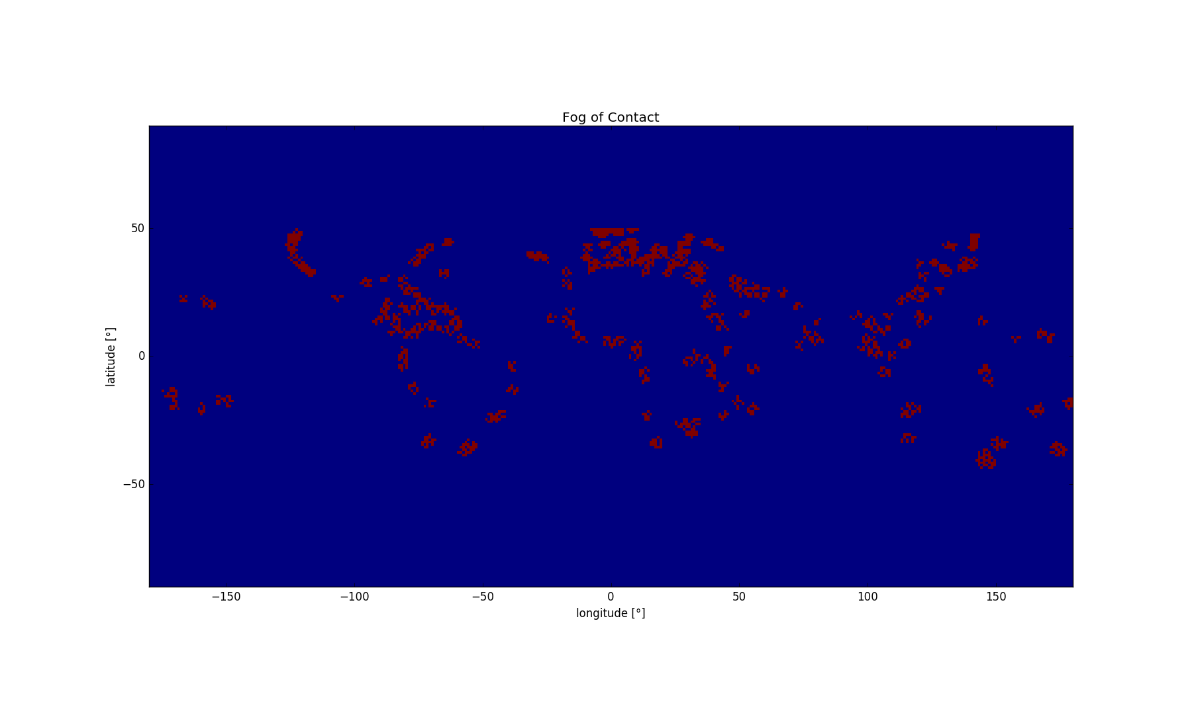
Paradigm Shift – design criteria
Scalability
performance of nodes & backend
reliability and maintenance
=> INVESTMENT
Location
mission requirement
local infrastructure (internet, power)
=> INFRASTRUCTURE
13

Slide 14
Paradigm Shift – advantages
IoT opens a new
direct and indirect roadmap
for space ops…
big data & more open (source) data
standardized & open (source) interfaces
open (source) hardware and software
standardization committee and new open communities
open space segment eco-system
14

Slide 15
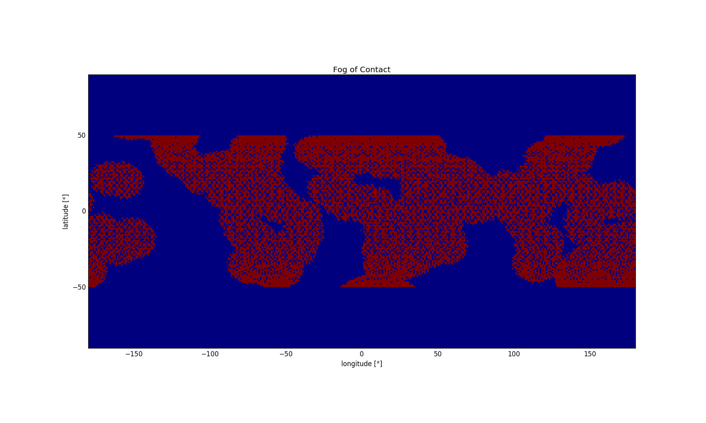
Paradigm Shift – trust and/or security
a global grid with accessible nodes
requires mutual trust!
multiple sources of error and attack vectors…
manipulation of data on the node
manipulation of location
manipulation of availability
manipulation of hardware and
manipulation of command and control (if transmission is required)
15

Slide 16
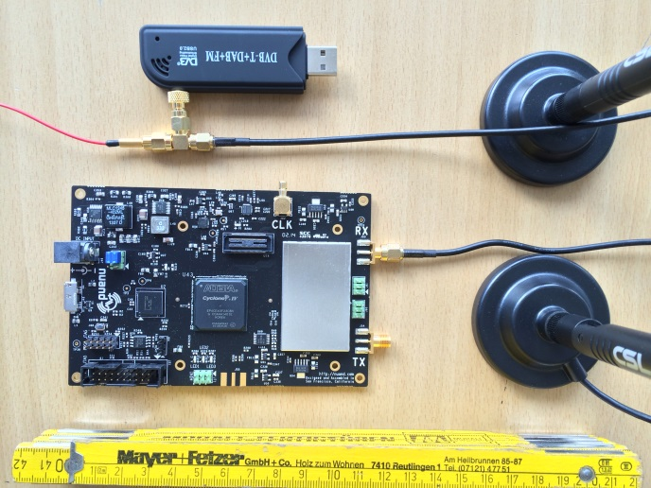
Conclusion
Internet of Things era is there!
will be / is already the infrastructure of space ops
offers advantages in automation especially for mega constellations like OneWeb and SpaceX
offers new tools and cooperations for small organizations
raises demand for new security approaches
raises demand in infrastructure
Distributed Ground Station Network (DGSN)
IoT is the only way for scalability
comparison metric supports “island” deployment approach (core network of clustered stations + open for external users)
open-source approach supports mutual trust
cooperative design and operation
measuring everything! Transmission at a later phase
16

Slide 17







want to join a global internet-connected satellite tracking grid
or are you in need to find you missing CubeSat?
Distributed Ground Station Network
CreativeCommons By-NC-SA applies
Thank you for your attention!
hornig@aerospaceresearch.net
code on github.com/aerospaceresearch
FairUse
applies
on logos
and fotos
with sources!
17

